Slide 1
MAST6100 Final Project
Predicting Telco Customer Churn
Modern Learning Models

Slide 2
Motivation/background
Customer churn - probability that a customer leaves
Losing customers costs the company money
It is much more effective to keep customers than get new ones to join
Telco is a company that experiences customer churn and has a large dataset with over 7000 observations and 20 features.
This should allow the use of multiple modern modelling techniques to be applied to the dataset to predict customer churn.
Notes:
Customer churn—the likelihood that a customer leaves a service— this poses a major financial challenge in subscription-based industries such as telecommunications. Retaining customers is more cost-effective than acquiring new ones, making churn prediction (and prevention) an essential task in applied machine learning.
The Telco Customer Churn dataset provides real-world customer records for predicting whether a telecom customer will leave the service. This topic is appealing because:
It is a well-studied business problem with practical importance.
The dataset is rich, containing over 7,000 observations, 20+ features and with a kaggle usability score of 8.82, enabling the use of a range of different models.
It allows for comparing both classical statistical methods and modern machine-learning/deep-learning approaches.
Recent academic research continues to explore churn prediction using machine learning. Studies such as Amin et al. (2017) and Peng & Peng (2022) demonstrate that advanced techniques like deep learning and XGBoost often outperform classical statistical models such as logistic regression, highlighting the need to evaluate a range of methods.
This project aims to build upon these findings using the methods we have learned in the course.

Slide 3
Research Questions
Can customer churn be effectively predicted using demographic, account, and service-related variables?
Which classification method provides the most accurate and reliable churn predictions?
How do classical models (e.g., Logistic Regression) compare with more flexible models such as Random Forests, SVMs, and MLPs?
Which features contribute most strongly to predicting customer churn?
Notes:
The Main question is stated here with us wanting to be able to model customer churn the best based on a range of factors with the aim that successfully being able to predict customer churn will help to be able to identify at risk customers and prevent customer churn.

Slide 4
Data
Dataset: Telco Customer Churn - csv file from kaggle
Variables:
~7000 customers (rows of data)
21 variables including:
Demographic features: gender, senior citizen, partner, dependents
Account information: tenure, contract type, monthly charges, total charges
Service subscriptions: internet service, phone service, multiple lines, tech support, etc.
Target variable: Churn (Yes/No)
Strong class imbalance: ~27% churn vs 73% non-churn.
70/30 train-test split used.
Notes:
The dataset source is Kaggle: Telco Customer Churn dataset — collected from a telecommunications company providing information about customer behaviour, subscription details, and churn status.
Data downloaded as a CSV file from Kaggle and imported into R using read.csv().
Variables:
~7,000 customers
21 variables including:
Demographic features: gender, senior citizen, partner, dependents
Account information: tenure, contract type, monthly charges, total charges
Service subscriptions: internet service, phone service, multiple lines, tech support, etc.
Target variable: Churn (Yes/No)
Initial Limitations:
Some variables are categorical and require encoding
TotalCharges contains missing or non-numeric entries that must be cleaned
Strong class imbalance: ~27% churn vs 73% non-churn
Several factors may be correlated (risk of multicollinearity for GLM)
The variable TotalCharges was stored as a character vector because 11 entries contained blank spaces rather than numeric values. These blank entries were first converted to NA, after which all incomplete rows were removed. This resulted in a final modelling dataset of 7,032 complete observations. The variable was then converted to numeric to reflect its interpretation as a continuous billing-related measure.
A 70/30 train-test split was used.

Slide 5
Modern Models
Linear Discriminant Analysis (LDA) - interpretability and closed-form structure
Decision Tree - Trees are fully non-parametric and can capture nonlinear interactions without requiring transformations
Boosting (GBM) - distribution = bournoulli , initial trees = 5000, shrinkage = 0.01, full training set
Neural Network (MLP) - size = 5 , decay = 0.0005, maxit = 200
Comparison metrics: accuracy, sensitivity (true positive), specificity (true negative)
Notes:
In this context true positive is the amount of correctly predicted churners, and true negative is the amount of correctly predicted non-churners.
Decision trees can be pruned reducing branches and nodes which may reduce accuracy on the training dataset but reduces variance and reduces the risk of overfitting.
Boosting (GBM) - sequentially fits weak learners—here, decision stumps—to correct residual errors at each iteration.
distribution = "bernoulli", # For binary classification
n.trees = 5000, # Initial number of trees (we'll tune later)
interaction.depth = 1, # Stumps
shrinkage = 0.01, # Learning rate
bag.fraction = 0.5, # Stochastic gradient boosting
train.fraction = 1.0, # Use full training set
n.cores = 1 # Keeps results reproducible
Out of bag estimation selected an optimal iteration count of 925 trees.
Boosting also revealed the variables that were the strongest predictors.
size = 5, # number of hidden units
decay = 5e-4, # weight decay (regularisation)
maxit = 200, # maximum iterations
Neural networks form predictions by applying weighted linear transformations to the input variables, followed by nonlinear activation functions, allowing the model to represent complex decision boundaries that cannot be captured by linear methods such as LDA.

Slide 6
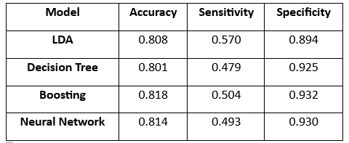
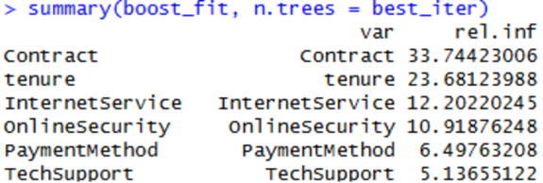
Results
Performance of models on the test set:
LDA: Acc 0.808, Sens 0.570, Spec 0.894
Decision Tree: Acc 0.801, Sens 0.479, Spec 0.925
Boosting: Acc 0.818, Sens 0.504, Spec 0.932
Neural Network: Acc 0.814, Sens 0.493, Spec 0.930
Boosting had the best accuracy and specificity score (best overall)
LDA had the best sensitivity score (best solely to detect churners)
←Boosting revealed which variables were the strongest predictors

